Slide 1
http://www.dongyang-home.co.kr/

Slide 2
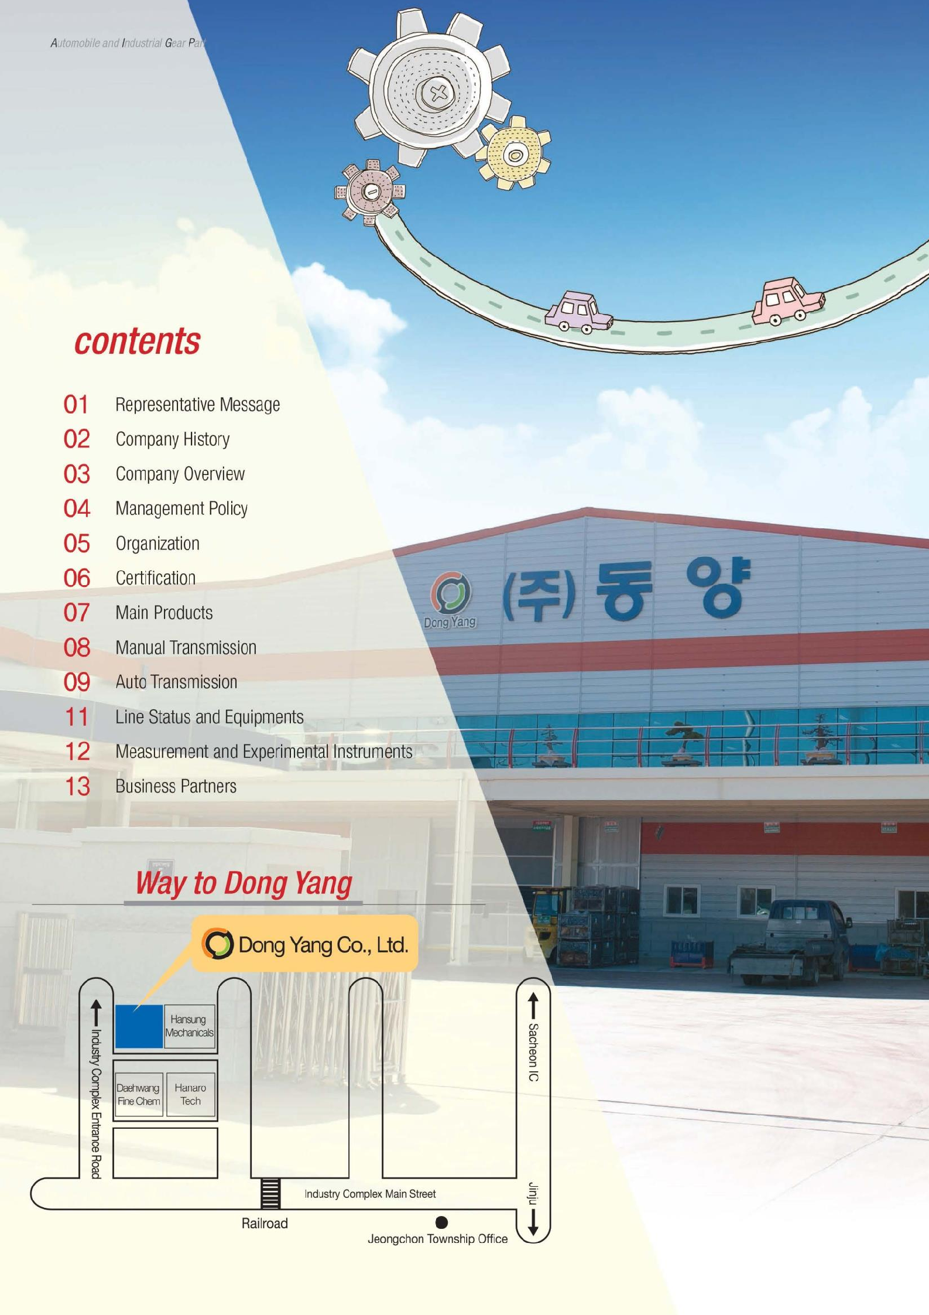
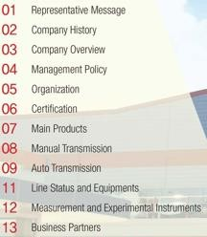
01
Representative Message
02
Company History
03
Company Overview
04
Sales Revenue
Management Policy
05
06
Organization Certification Main Products
Line Status and Equipments
07
08
09
10
Measurement and Experimental Instruments

Slide 3
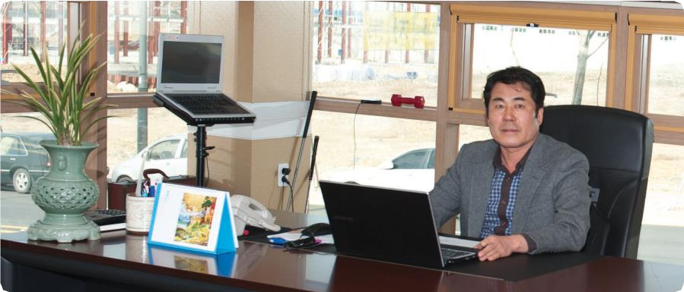
Company dreaming to be the Global New Leader in Automobile and Industrial Gear Parts
Dong Yang Co., Ltd.
Representative Message
First of all, we express our thanks to the clients for cheering and bracing up our company. Dong Yang Metal Ind. Co. was established in 1995 and changed its name as Dong Yang Co., Ltd. in 2008. We produce core automotive parts such as synchronize-sleeve.
We pledge to produce more upgraded, professionally and technically developed products to satisfy the new-needs of the clients about the car through continued research and development activities as well as through technical reform.
We are determined to expand a future-oriented investment based on the accumulated experience and reliance in order to meet our customers requirements.
We will do our best effort to challenge the newest technologies.
president Dae-Geun, Mun
01

Slide 4
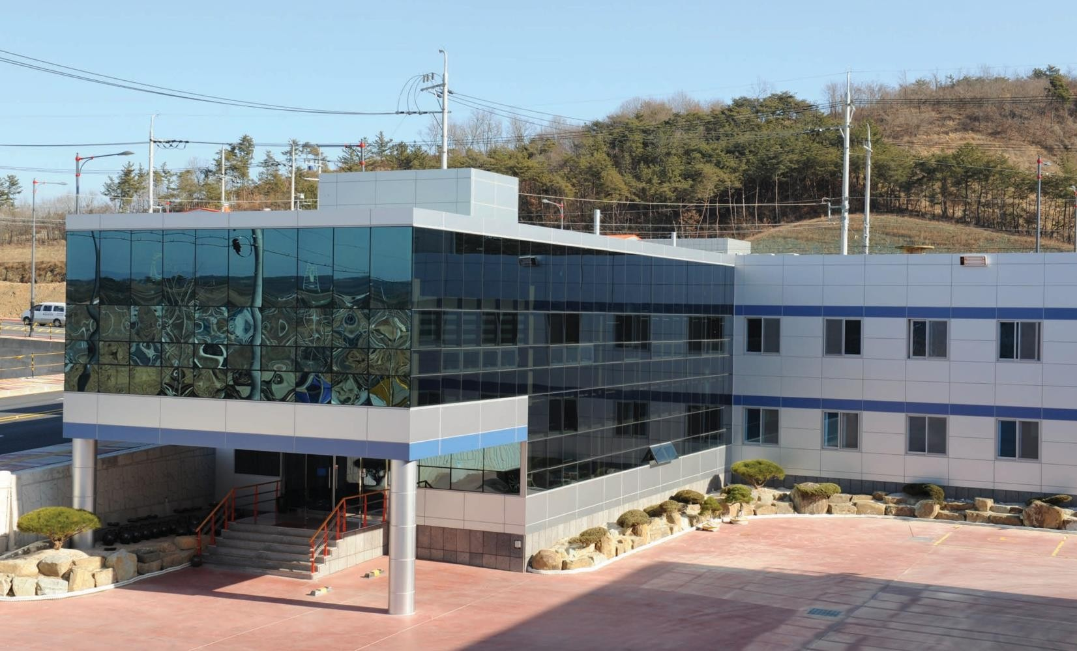
Company History
1995.02 | Established Dong Yang Metal Ind.co.
2004.03 | Certified ISO/TS 16949 Quality System
2004.04 | Started Exporting TRUNION of DAIKIN Company in Japan
2008.12 | Established Dong Yang Co., Ltd.
2009.03 | Started Producing Auto Transmission Parts(6 speed, 8 speed)
2012.08 | Moved to industrial complex in Jeongchon, Jinju
2012.11 | Acquired Powertech PSQ
2015.05 | Acquired RSM SES-TIER2
2019.02 | Established Dong Yang R&D center
2019.11 | Acquired INNOBIZ
2020.01 | DYPS(Built Manufacturing Execution System)
2020.07 | Started Producing Hybrid Parts(MQ4 Rotor Sleeve, Outer Boss)
2021.01 | Started Producing Electric Parts(NE, CV, JW Rotor Shaft)
2021.03 | Acquired KPIC(Korea National Ppuri Industry Center)
2022.06 | Pacific X Korea – FORD(Hybrid parts indirect export)
2023.03 | RSM SES-TIER2 certification renewal
2023.09 | Designated as a leading company for Energy Efficiency Innovation Leading Project (KEEP+)
2023.10 | Received the Minister's Award(Manufacturing Innovation Category)
2023.12 | Received the 2023 Jinju City CEO Award
02

Slide 5
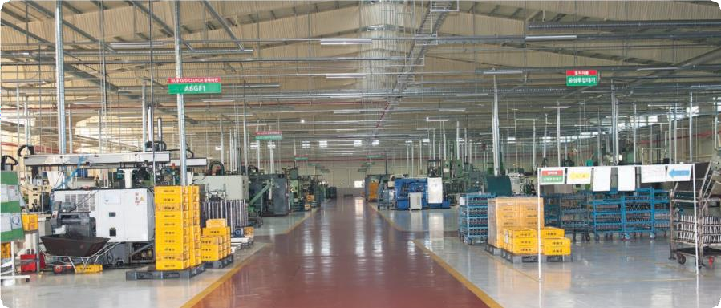
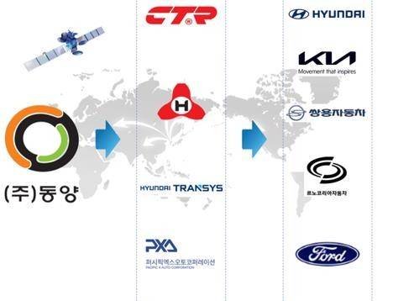
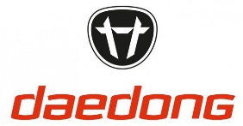
Company dreaming to be the Global New Leader in Automobile and Industrial Gear Parts
Dong Yang Co., Ltd.
Company Overview
Land Building Site
Employees Established
14,782㎡
10,700㎡
120
May 2008
Allied industries
03

Slide 6
Company dreaming to be the Global New Leader in Automobile and Industrial Gear Parts
Dong Yang Co., Ltd.
Sales Revenue
Sales in 2022
Customer
Revenue |  | Market share
49.87 billion |  | 96.3%
1.14 billion |  | 2.20%
0.77 billion |  | 1.48%
0.01 billion |  | 0.01%
0.01 billion |  | 0.01%
기타
TOTAL : 51.8 billion won
Sales trend by year
04
3
2010 2011 2012 2013 2014 2015 2016 2017 2018 2019 2020 2021 2022

Slide 7
Company dreaming to be the Global New Leader in Automobile and Industrial Gear Parts
Dong Yang Co., Ltd.
Management Policy
Attitude of being considerate and respectful to others
Best technology and best quality of products
Trying to be a company with the basis of being considerate and respectful people and the best technology, putting continuous effort and having the mind that we can overcome the technological limit, and therefore produce products of best quality and thinking on the customers’ side.
Automobile parts manufacture
Automobile and industrial gear manufacture company
Made-to-order
Custom-built
Own design
Own experiment
Ungrudging investment
Secured ultra precise technology
Management of R&D center
05

Slide 8
Company dreaming to be the Global New Leader in Automobile and Industrial Gear Parts
Dong Yang Co., Ltd.
Organization
◎ Process innovation
▶ Management planning
▶ Operation management
business performance
education
▶ System resource management
▶ DYPS(MES management)
◎ Sales & Administration
▶ Sales
- Contract and supply of products to customers
▶ Account
▶ Human resources and Labor
◎ Development
▶ New product development
Obtain ISIR
Process design
Subcontractor development
▶ Design and manufacture of tool
▶ R&D center
◎ Purchasing
▶ Tool purchase
▶ General purchase
▶ Outsourcing
◎ Quality management
▶ Export examination
▶ Process examination
▶ Shipment examination
▶ Nonconformance management
▶ Client quality response
◎ Manufacture and
manufacture administration
▶ Manufacture administration
▶ Outsourcing administration
▶ Facility preservation and administration
06

Slide 9
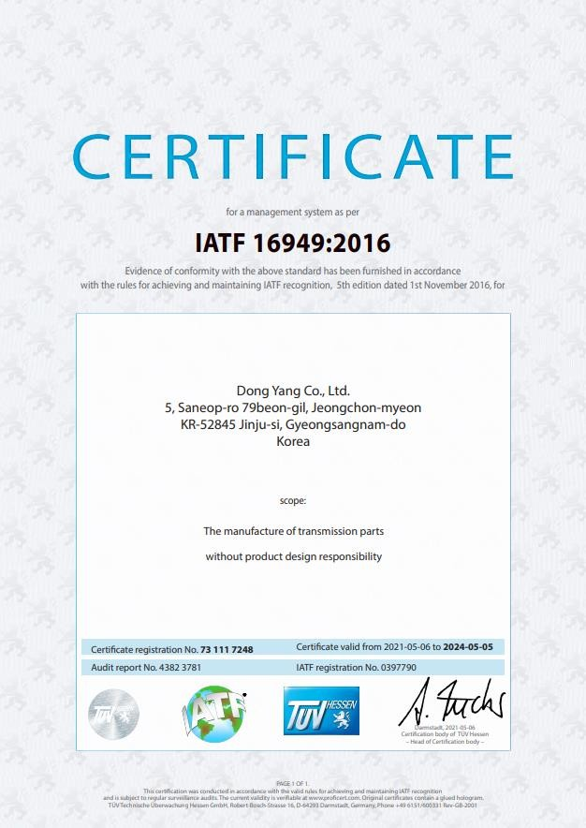
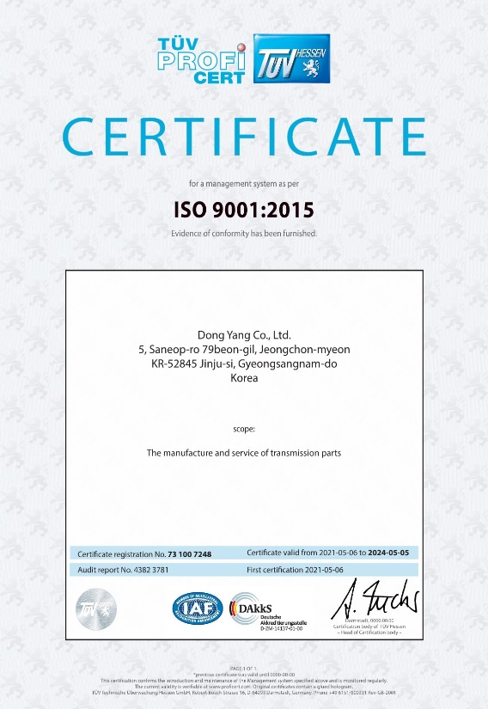
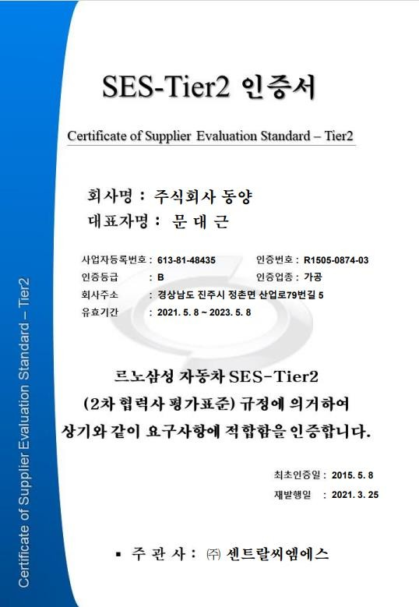
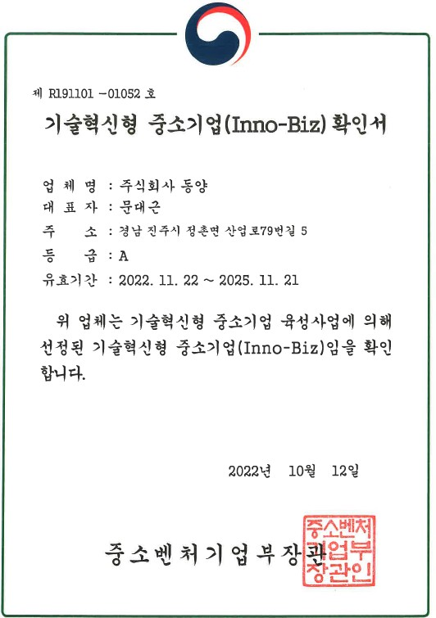
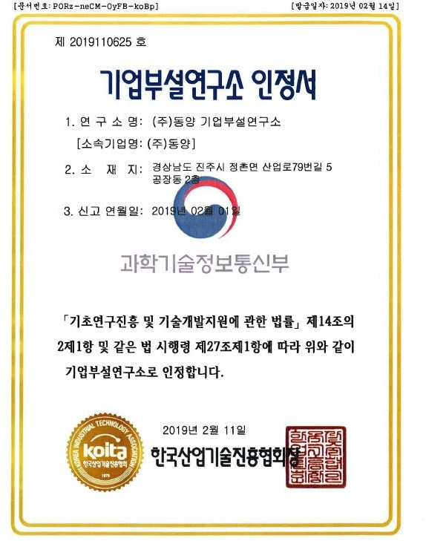
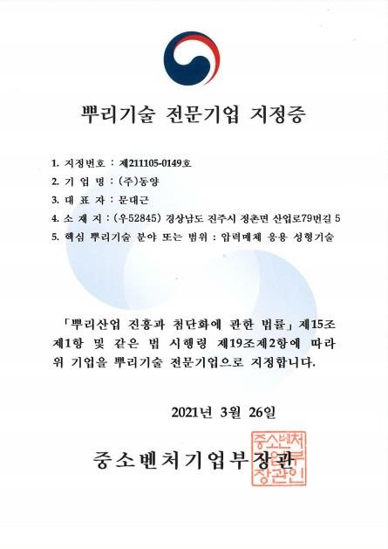
Company dreaming to be the Global New Leader in Automobile and Industrial Gear Parts
Dong Yang Co., Ltd.
Certification
Certification
Certification
07

Slide 10
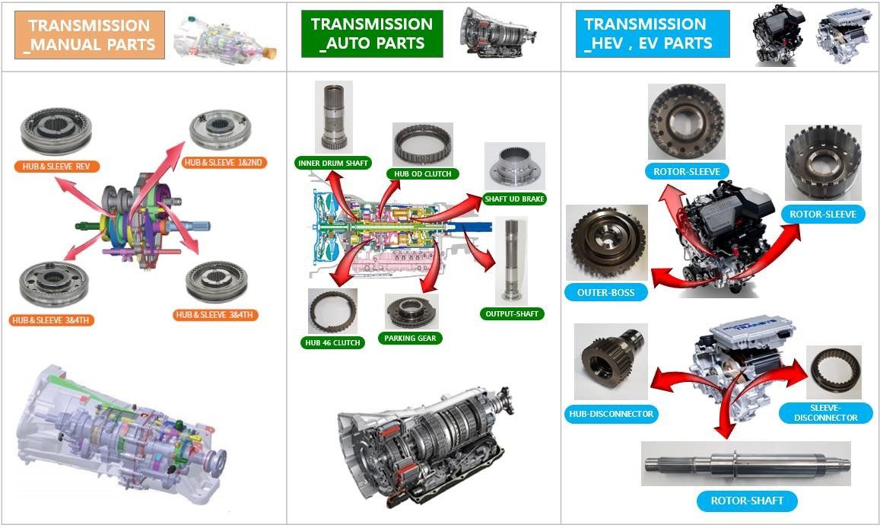
Company dreaming to be the Global New Leader in Automobile and Industrial Gear Parts
Dong Yang Co., Ltd.
Main Products
HUB & SLEEVE 5&6TH
Finished Car Customer | HYUNDAI KIA GM KG Mobility | HYUNDAI KIA KG Mobility | HYUNDAI KIA FORD
Type of Vehicle | Poter Sonata(Taxi) GENESIS Coupe STAREX MIGHTY SOLATI BONGO DAMAS LABO TIVOLI | GENESIS AVANTE GRANDEUR SONATA K7 K8 K9 MOHAVE REXTON | IONIQ 5 IONIQ 6 EV6 Genesis EV Sorento HEV / P-HEV Santa Fe HEV / P-HEV FORD Explorer HEV
08

Slide 11
Company dreaming to be the Global New Leader in Automobile and Industrial Gear Parts
Dong Yang Co., Ltd.
Line Status
NO | Line Name | Facility Composition | Product Name | Number of Lines
1 | SYNCHRONIZE SLEEVE LINE | BROACH-ROLLING-CHAMFERING- BROACH2-LATHE-MCT | SYCHRONIZER- SLEEVE | 9
2 | O/D LINE | SHAPER-PIERCING-BROACH-MCT | HUB O/DCLUTCH | 2
3 | ROTOR SHAFT LINE | TURNING-MCT-BROACH | ROTOR SHAFT | 1
4 | ROTOR SLEEVE LINE | MCT-CNC-HOBBING | ROTOR SLEEVE | 3
5 | OUTPUT SHAFT LINE | TURINIG-ROLLING-GRINDING | OUTPUT SHAFT | 2
6 | HUB46 LINE | HOBB’G-MCT-PIECING-BROACH | HUB46 | 3
7 | OTHER LINES |  |  | 16
Equipments
NO | Machine Name | Number | Others
1 | CNC TURNING MACHINE | 56
2 | BROACH MACHINE | 27
3 | MACHINING CENTER | 77
4 | HOBBING MACHINE | 12
5 | ROLLING MACHINE | 6
6 | CHAMFERING MACHINE | 12
7 | GEAR SHAPER | 17
8 | PIERCING MACHINE | 5
9 | GRINDING MACHINE | 16
10 | INDUSTRIAL ROBOTS | 50
11 | OTHERS MACHINE | 41
TOTAL |  | 319
09

Slide 12
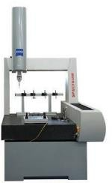
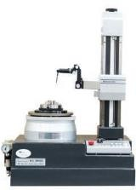
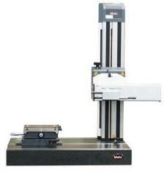
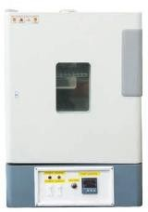
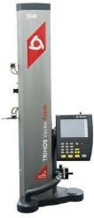
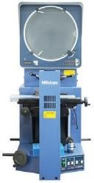
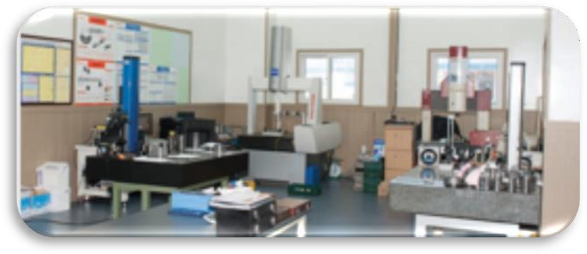
Company dreaming to be the Global New Leader in Automobile and Industrial Gear Parts
Dong Yang Co., Ltd.
Measuring and Experimental Instruments
Precise Measurement
3D measuring instrument
Roundness tester
Surface tester
Cleanliness tester
General Measurement
2D Measuring Instrument
Projector
Material & Heat
Rockwell hardness tester
Product, Fixture Design
Product Design
Fixture Design
1. Assembly optimized modeling
1. Maximize work efficiency
2. Gear Specifications
2. Stability of fixture
- Strength calculation
3. Realization possibility of the product
- Efficiency calculation
4. Self-manufacture of diverse fixtures
Verification of each design and manufacture
10

Slide 13
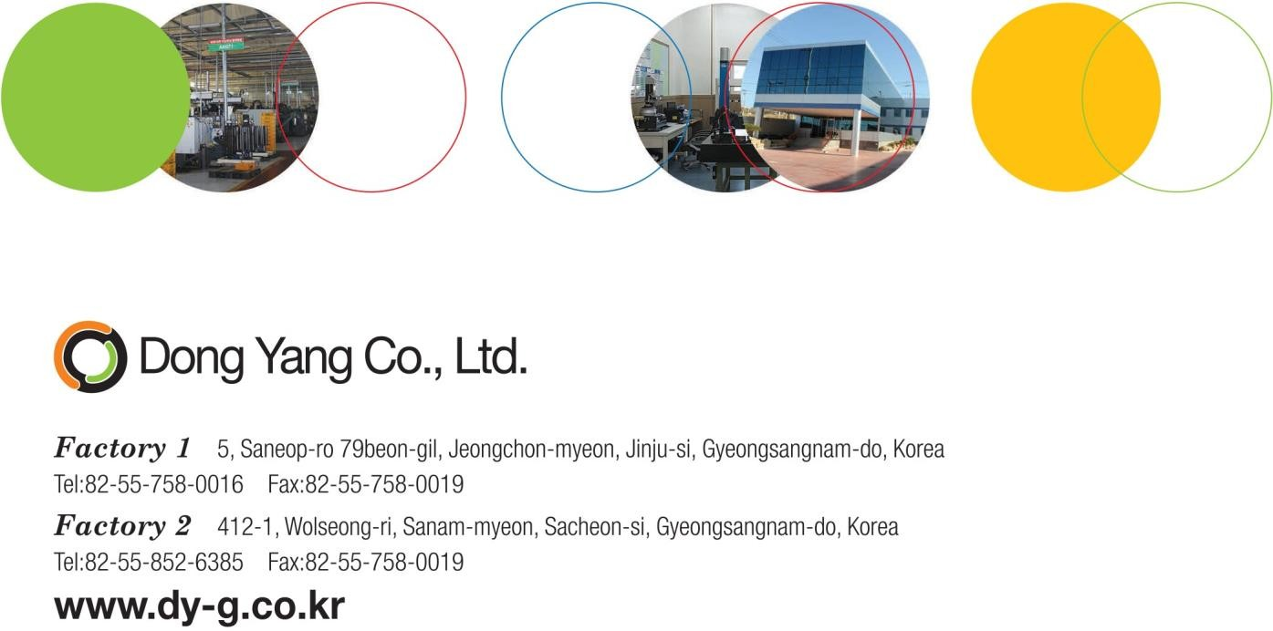
Factory 1 : 5, Saneop-ro 79beon-gil, Jeongchon-myeon, Jinju-si, Gyeongsangnam-do, Korea
Factory 2 : 11, Nangang-ro 1385beon-gil, Jinju-si, Gyeongsangnam-do, Gyeongsangnam-do, Korea
TEL: 82-55-758-0016 FAX: 82-55-758-0019
---------------------------------------------------------------------------------------------------------
http://www.dongyang-home.co.kr/bbs/content.php?co_id=eng_main

